Slide 1
Have you worked in multi-subscription environment? (Azure lighthouse – Multiple tenant), sentinel (workbook)
What are Azure polices, give few examples? (Azure policy and Blueprint provide the rules and structure on the subscription)
What is UDR (User defined Route) and how to configure it in Azure?
What are private endpoints in Azure?, Public endpoint, Bastion, Firewall, Ddos Protection, ExPress Route, Site to site , ASG, NSG, compute service (VM,VMSS,ACI,AKS,App Service, Function) , azure service, Publish repository on Linux server
What do you understand by IaC?
What is GitFlow branching model? (Feature branch, commit changes, Create PR, Code Review, Merge branch)
What tool do you use for creating Architecture in Azure? (Miro, Draw.io,
Do you have experience of managing kubernetes infrastructure in production environment?
Communication → VNET to Vnet, Subnet, VM, Subnet to Subnet, VM to VM
Azure SQL & Sql Database -LRS, GRS
Azure DevOps Variable (Global Varibable then how will you change env for prod, test. (How to call Azure secret in DevOps pipeline
If 1 machine is full (no space in disk) and 2nd If machine is down then what will be first step ?
Classic editor & Yaml
Can you Write DevOPS pipel line YAML file in notepad for Kubernetes Deployment, Service via Terraform (Strategy & Steps). Azure DevOps Pipeline CICD Steps with Resource access. (Only selected user can execute pipeline) . How do you call Variable, Azure Keyvault in pipeline. How Azure function in CICD Pipeline ?
Difference between Azure IAAS, PAAS, SAAS. (How Azure durable function statefull work.)
VM & VM ScaleSet , Vnet peering, Azure Policies, (Backup & Restore)
Read and write (Post and Put) , Logic app (Consumption, standard), logic app exception handling, debug issue
How to call variable in yaml file. (global variable, local variable, dynamic varibale)
How to balance traffic (Load Balancer, Front door, application Gateway, traffic manager)
Canary, Blue Green Deployment , Helm chart, init container, SideCar
Long running job on Azure function (time out 2 min in logic app or function then how will you handle ?
Notes:
https://medium.com/geekculture/how-to-use-key-vault-secrets-in-azure-pipelines-658198f2eea6

Slide 2
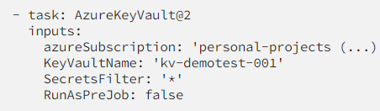

Slide 3
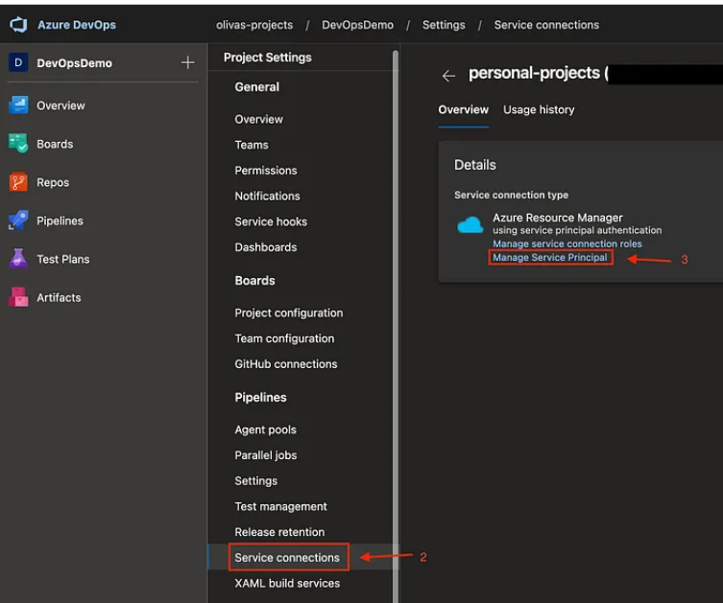

Slide 4
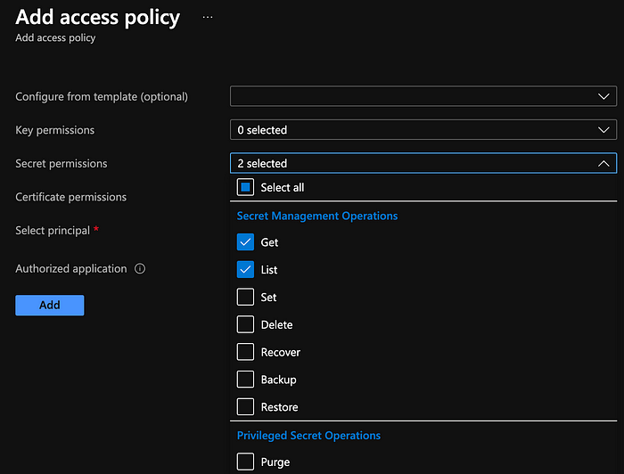

Slide 5
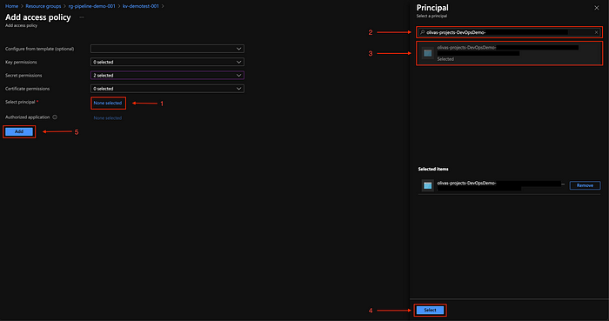

Slide 9
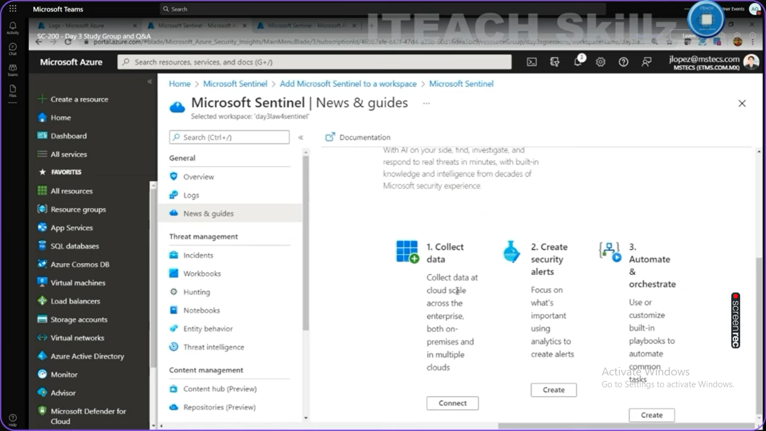

Slide 10
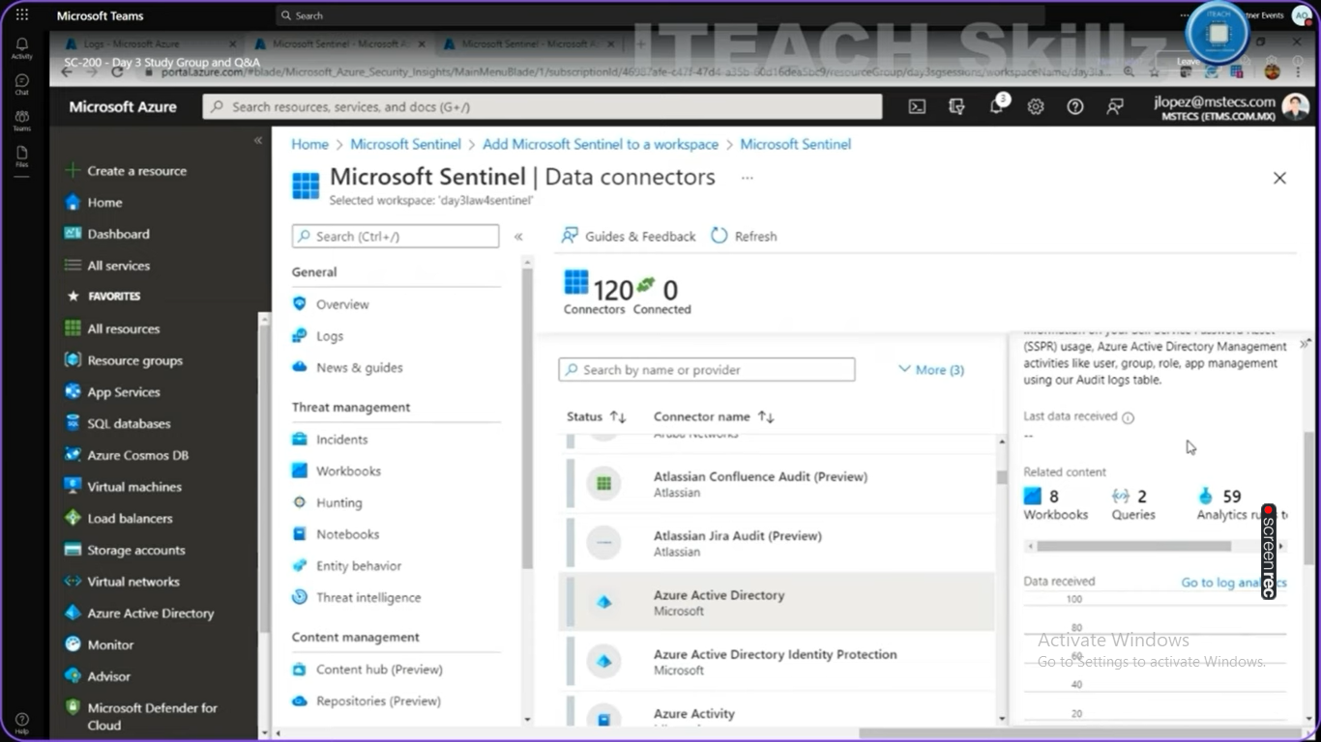

Slide 11


Slide 12
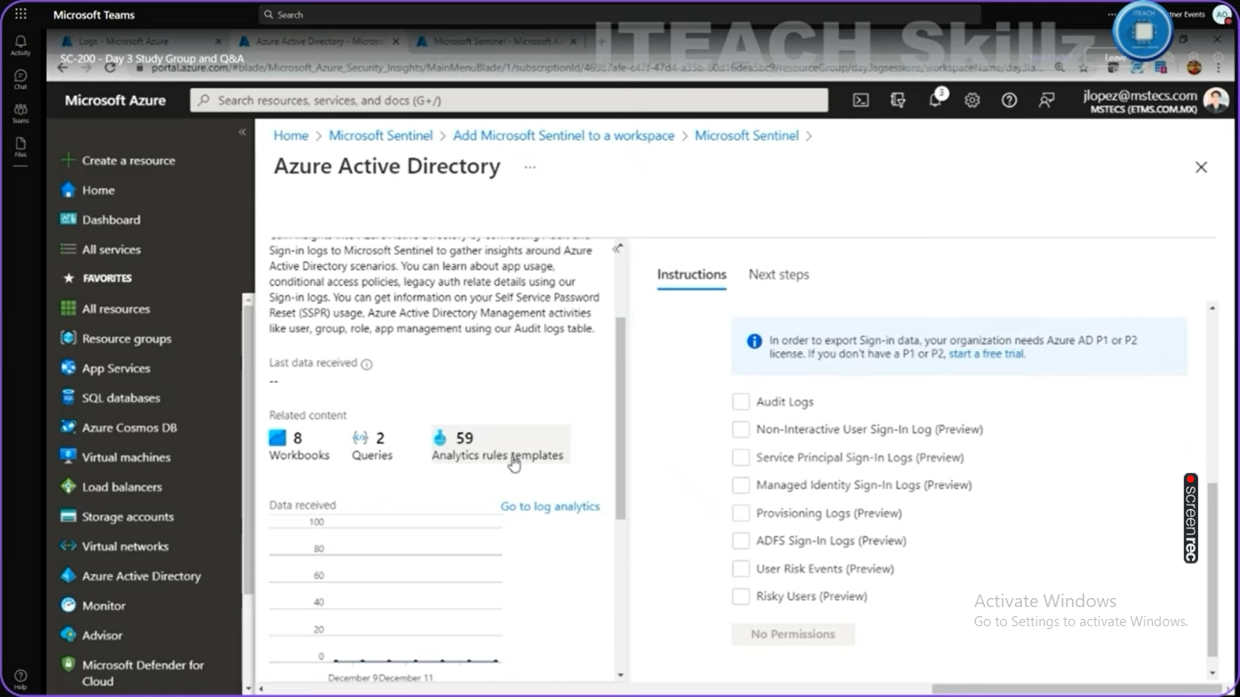

Slide 15
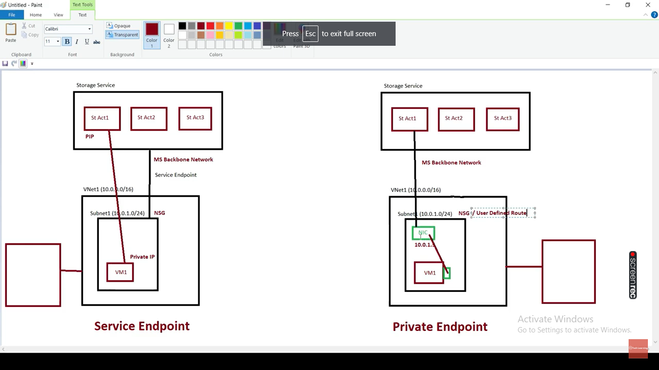

Slide 16
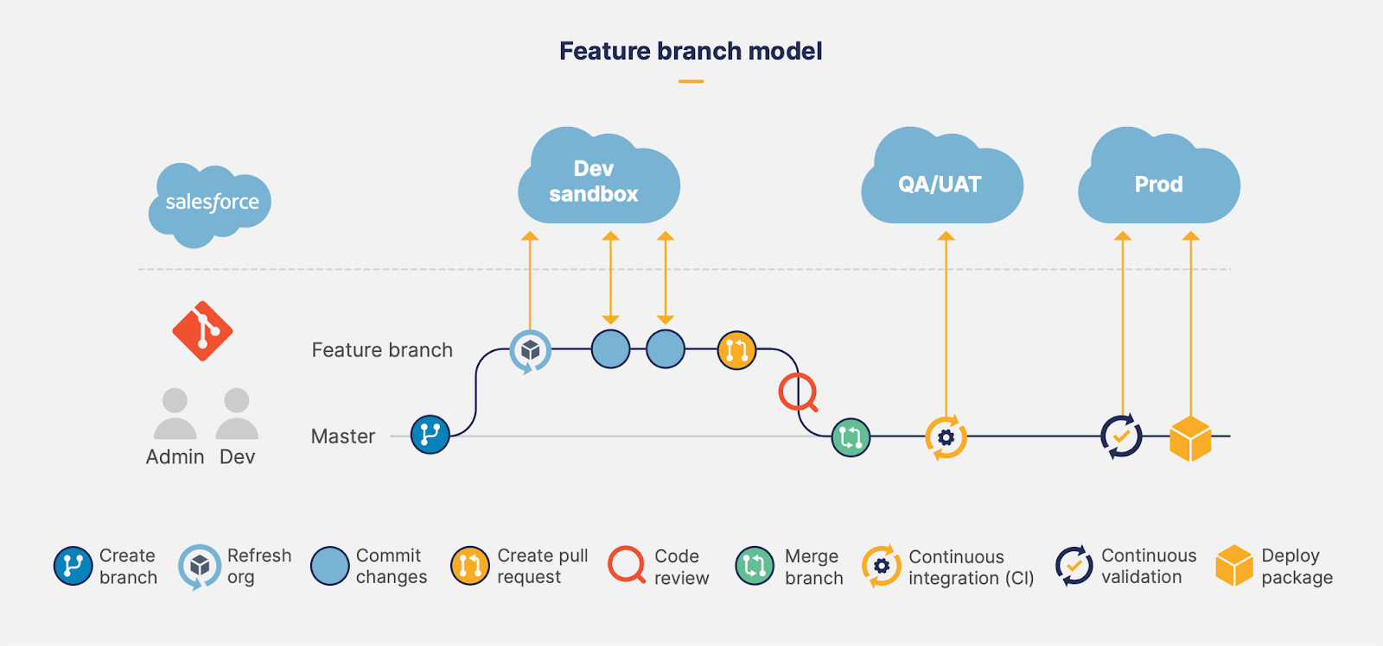
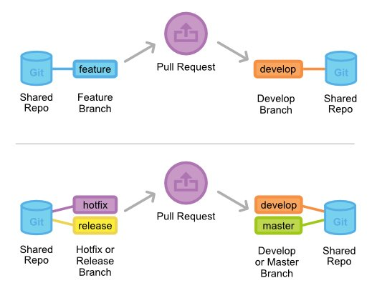

Slide 17
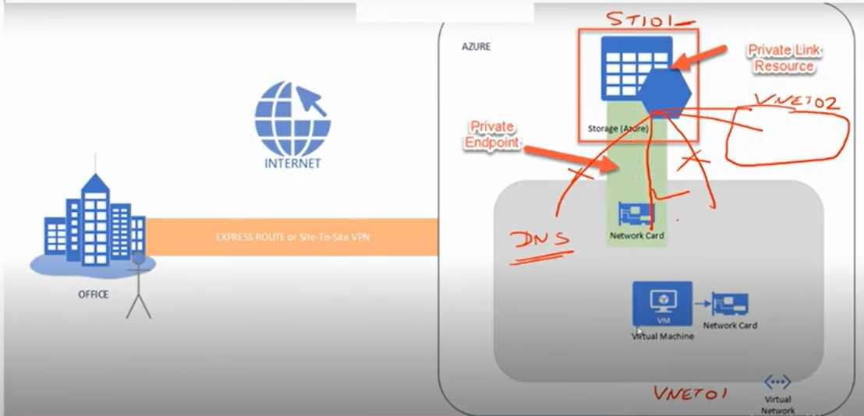

Slide 18
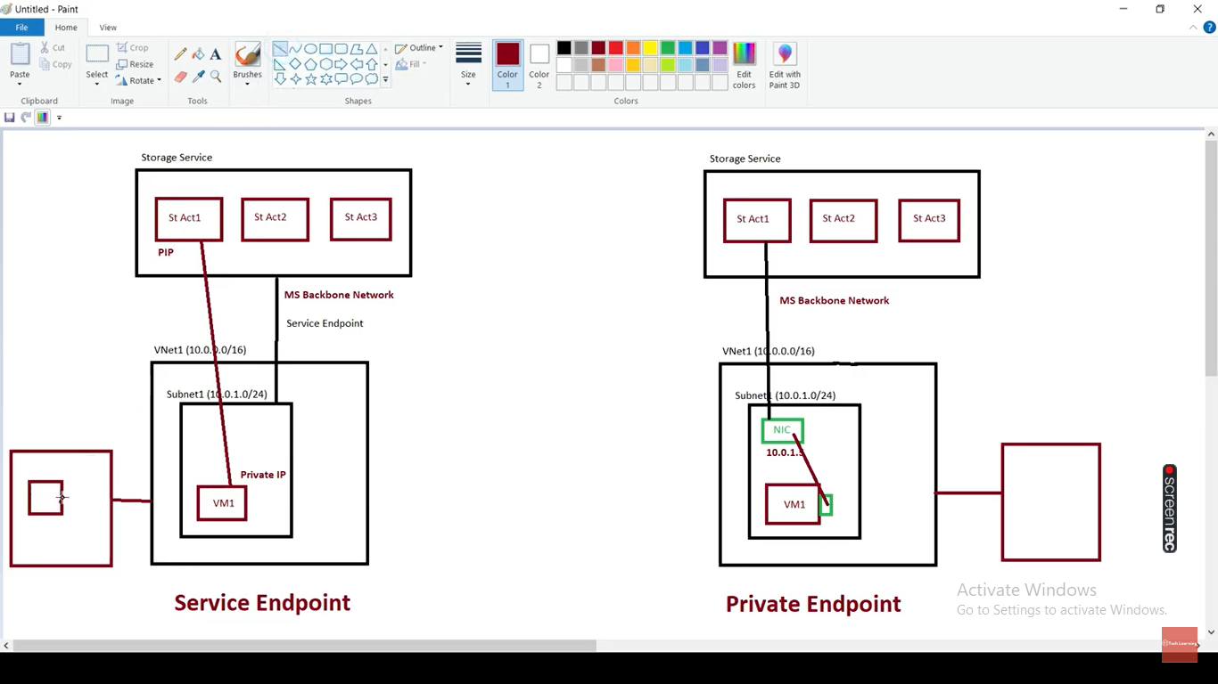

Slide 19
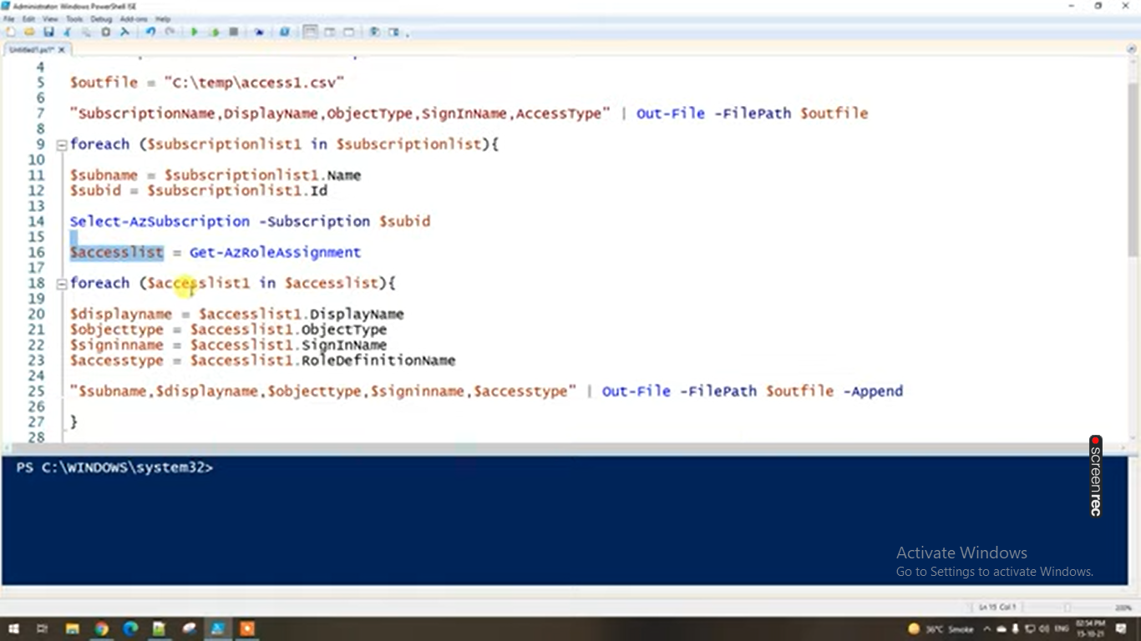

Slide 20
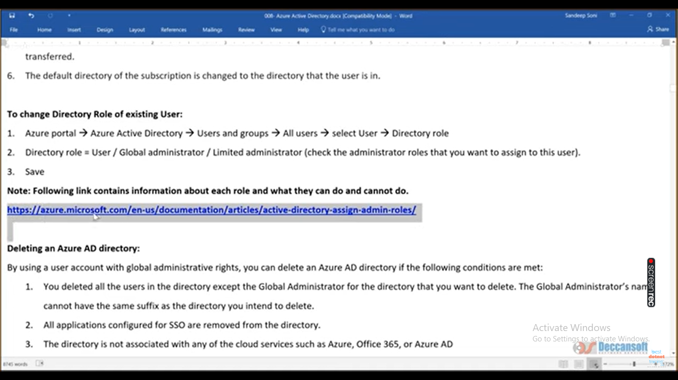

Slide 21
